Slide 1
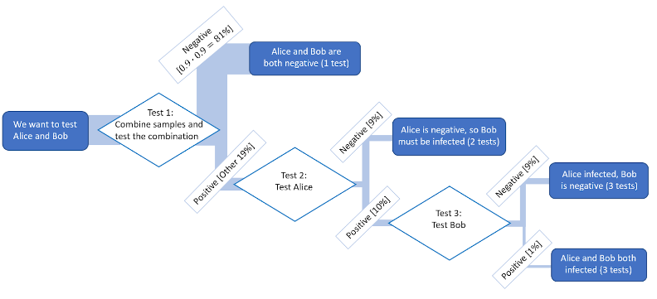



Max Entropy Testing (our solution)
Array Testing
Individual Testing

